Slide 1

Session 3
Linear Programming – Transportation
Big Data and Analytics
Topic 3:
Big Data Integration and Storage
We will wait for 5 to 10 mins for everyone to join

Slide 2
Recap
Linear Programming – Transportation
Installation of ANACONDA, Jupyter, and MongoDB Compass.
Running code with Python.
Understanding the characteristics of Big Data.
Naming the stages of the Data Life Cycle.

Slide 3

Recap
Linear Programming – Transportation
What we discussed last week?

Slide 4
Recap
Linear Programming – Transportation
Different sources of data;
The varying structures of data;
Notes:
Types of Data
Primary Data: Collected first-hand for a specific purpose.
Examples: Surveys, Interviews, Experiments
Advantages: Specific to your purpose, up-to-date, reliable.
Disadvantages: Time-consuming, often more expensive.
Secondary Data: Data collected by someone else, for another purpose.
Examples: Census data, archived research, databases.
Advantages: Easily accessible, cost-effective.
Disadvantages: Not specific to your needs, might be outdated.
Various Sources of Data
Internal Sources: Originates within the organisation or individual's domain. covering areas such as operations, maintenance, personnel, and finance.
Examples: Sales reports, feedback forms, company databases.
External Sources: Comes from outside the organisation or individual's domain.
Examples: Government reports, market research agencies, publications.
Structured Data: Data that adheres to a fixed format or schema.
Characteristics: Easily searchable. Highly organised. Defined length and format.
Examples: Relational databases (like SQL). CSV files. Excel spreadsheets.
Advantages: Efficient for querying. Easily analysed. Supports transactions.
Disadvantages: Inflexible to changes in schema. May not capture all types of data.
Semi-Structured: Data that doesn't have a rigid structure but contains tags, hierarchies, or other markers to group and convey relationships between elements.
Characteristics: Contains tags, elements, and attributes. Not organised in rows and columns.
More flexible than structured data.
Examples: XML documents. JSON files. Email.
Advantages: Offers flexibility in data capture, Contains meta-data, Can be converted to structured format if necessary.
Disadvantages: Less efficient to query than structured data.
May require more storage space.
Unstructured: Data that doesn’t have a specific form or model.
Characteristics: No pre-defined model. Harder to analyse and query. May come from various sources.
Examples: Social media posts. Multimedia content (videos, images, audio).
Advantages: Captures data in its natural form. Flexible and varied. Represents human input and interaction well.
Disadvantages: Requires advanced tools and methods to analyse. Not easily searchable. Storage can be a challenge due to volume and variety.

Slide 5
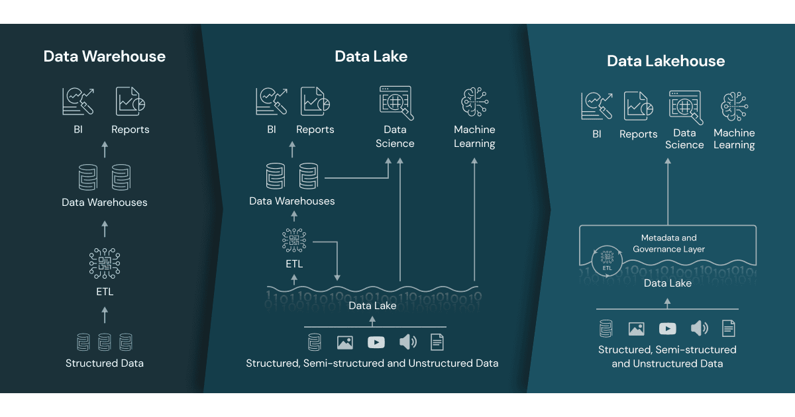
Recap
Linear Programming – Transportation
The ‘data lake’
Notes:
Centralised storage repository
Data Lake Key Characteristics:
Stores structured, semi-structured, and unstructured data.
Uses a flat architecture where data is identified and tagged with unique identifiers.
Highly scalable.
Can store real-time data.
Supports multiple data types, including real-time streams.
Can easily grow with the business, adapting to increasing data loads
Facilitates complex analytical tasks, like machine learning, directly on the large datasets.
Often built on open-source technologies, allowing for cost-effective scaling.
ETL: extract, transform and load

Slide 6
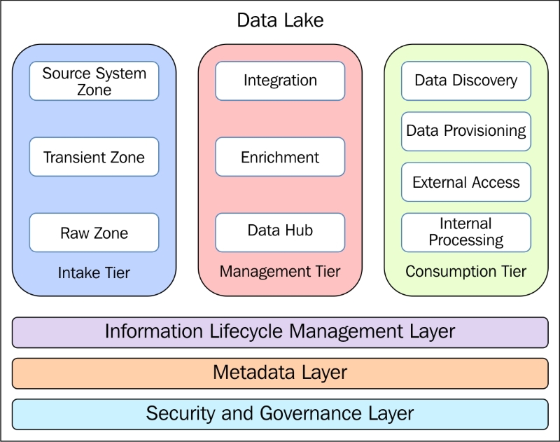
Recap
Linear Programming – Transportation
Data Lake Tier
Notes:
In the previous module, you were introduced to the overall architecture of a data lake, which consists of three stages: 1) the intake tier; 2) the management tier; and 3) the consumption tier. You also learned about the first component of a data lake; that is, the data intake tier, which focuses on sourcing and ingesting data from different sources and of varying structures. The next logical step is to provide a unified view of the data by integrating, enriching and storing the data derived from various sources.
This Module focuses on the next component of the data lake; that is, the data management tier, which essentially addresses the challenges related to the integration, enrichment and storage of big data.

Slide 7
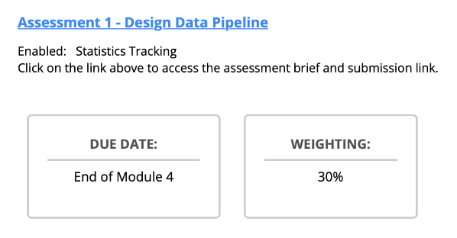
Assignment due next week
Linear Programming – Transportation

Slide 8
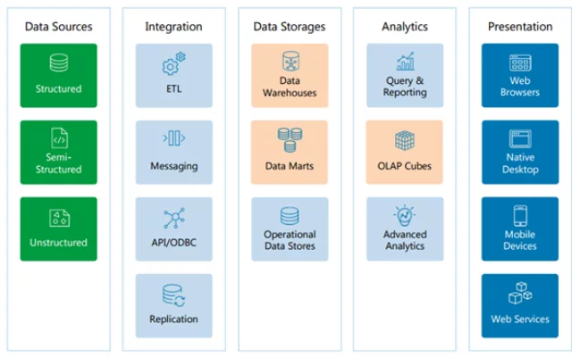
Session 3: Big Data Integration and Storage
Linear Programming – Transportation
Big Data Integration:
Refers to the process of:
collecting,
combining,
managing, and
consuming data
from various sources to:
derive insights,
improve decision-making, and
achieve organisational objectives.
Notes:
Big Data Integration combines data originating from a variety of different sources and software formats, and then provides users with a translated and unified view of the accumulated data.
Managing “integrated” Big Data assures more confidence in decision-making and provides superior insights. The process of integrating huge data sets can be quite complicated and can present several challenges
ETL: extract, transform and load.
Messaging system enables users to transfer data from one application to another or one device to another.
API: application programming interface. APIs are used to connect applications and systems without requiring manual coding
(ODBC: Open Database Connectivity is an open standard Application Programming Interface (API) for accessing a database
Data replication is the process of moving or copying data from one place to another or storing data simultaneously in more than one location.
A data mart is a simple form of a data warehouse that is focused on a single subject or line of business, such as sales, finance, or marketing.
OLAP cube is a data structure designed for fast analysis of data based on multiple dimensions (Product category (Sale records for Books, Electronics, Shoes, Clothes) + Time ( Quarter 1, 2, 3, 4) + Location (Store A, B, C, D )

Slide 9
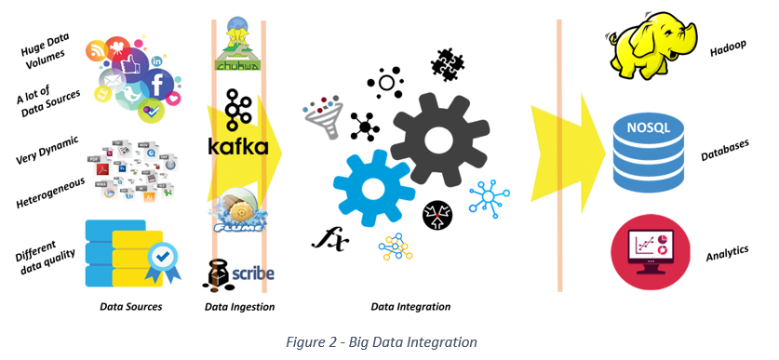
Session 3: Big Data Integration and Storage
Linear Programming – Transportation
Notes:
It requires multiple tools and techniques to be ready for analysis
Heterogeneous: Diverse in character or content
Some challenges faced during the integration process include: uncertainty of data, management, syncing across data sources, finding insights, and skill availability.
Big Data Integration combines traditional data, social media, data from the Internet of Things (IoT), and transactional data. Data that is not compatible, or has not been translated/transformed, is essentially useless for such projects.

Slide 10
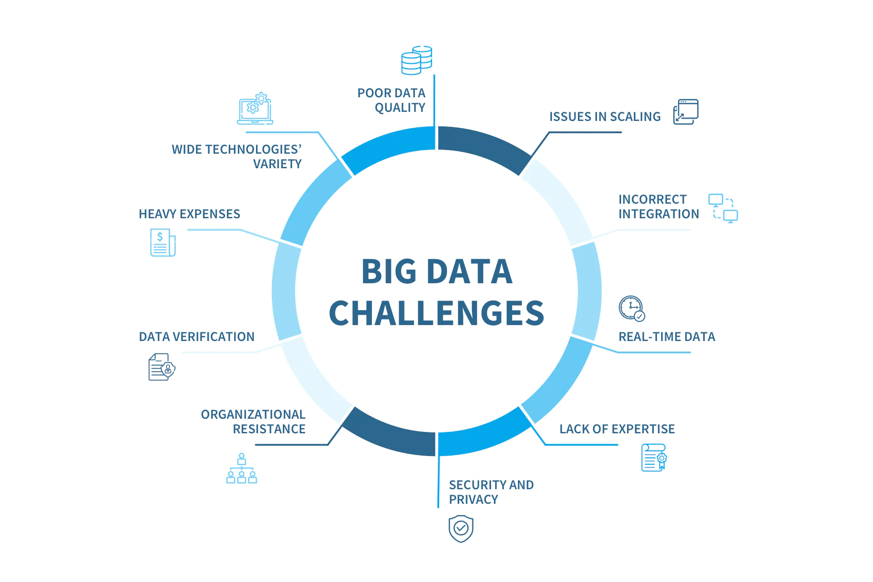
Session 3: Big Data Integration and Storage
Linear Programming – Transportation
The Challenges of Big Data Integration
Lack of expertise
Bringing in the Data
Synchronisation
Data Management Tools
Choosing a Strategy
Notes:
Finding Staff: the number of data scientists and Big Data analysts continues to grow, there is still a lack of people to fill all the positions in the Big Data research industry. The typical Big Data expert has gained experience with tool implementation and has an understanding of how to organize the data to best research it. Data scientists and Big Data analysts should be familiar with traditional relational database tools, as well as in-memory analytics, NoSQL Data Management frameworks, and Hadoop ecosystems.
Bringing in the Data: The issues involved with accessing data coming from an extensive range of sources is also a challenge. The skills needed to navigate the extraction processes are necessary for the goal of analysing and processing Big Data.
Synchronization: Data coming from a wide range of sources uses different schedules and rates, and can quickly become desynchronized from the originating system. Data synchronization provides consistency in systems and continually updates to maintain that consistency. In traditional Data Management systems, the process of data extraction, migration, and transformation all promote desynchronization.
Data Management Tools: Incompatibility between Big Data Management tools can cause problems. They can be incompatible NoSQL approaches — hierarchical object representation and the key-value storage provide two good examples. The range of NoSQL tools has caused some confusion regarding the compatibility of different approaches. Selecting the appropriate tools for a highly functional data integration system requires forethought. Small organizations that are planning to start data warehousing face a decision about the tools they will be using.
Choosing a Strategy: Big Data Integration often begins with a simple need to share information. This is often followed by an interest in breaking down the “data silos” for purposes of analysis. Businesses will often leap from one project to another without an organizational plan. To meet goals that are sometimes contradictory, and include security and compliance needs, a true data integration strategy should be developed.

Slide 11
Session 3: Big Data Integration and Storage
Linear Programming – Transportation
Data Pipeline:
A series of automated data processing steps and tools that:
transport and refine raw data
from source systems to analytics databases or operational systems.
Data pipelines enable:
data transformation,
enrichment, and
movement to ensure that data is readily available,
trustworthy, and
in the right format for analysis.
Notes:
The Core Analogy: A Water Pipeline
Think of a data pipeline like a water purification and delivery system.
Source System = A muddy river (your raw, unorganized data).
Data Pipeline = The series of pipes, filters, and treatment plants.
Analytics Database = The clean water tap in your kitchen, ready for consumption (analysis).
The pipeline's job is to take the "muddy" raw data and clean, transform, and transport it so it's safe and useful for "drinking" (analysis).
Along the way, the pipeline doesn’t just move the data; it also:
Transforms it (changing it into a usable structure or format).
Enriches it (adding extra context, joining with other data, cleaning).
Ensures quality and trustworthiness (so analysts can rely on it).

Slide 12
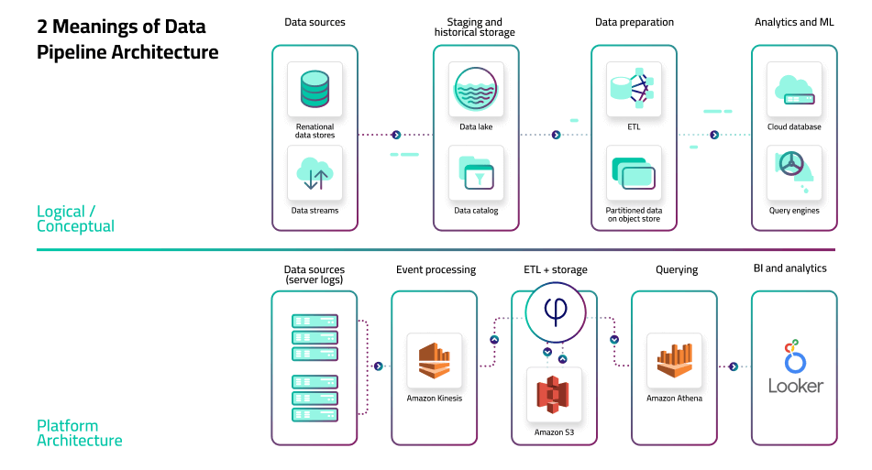
Session 3: Big Data Integration and Storage
Linear Programming – Transportation
Data Pipeline:
Notes:
Source of image: Upsolver
ETL stands for extract, transform, and load. Meaning, the transformation is happening after the data has been extracted from the source system but before it is loaded into the target system
The logical architecture that outlines the process and transformations a dataset undergoes, from collection to serving (see data architecture components).
The specific set of tools and frameworks used in a particular scenario, and the role each of these performs.

Slide 13
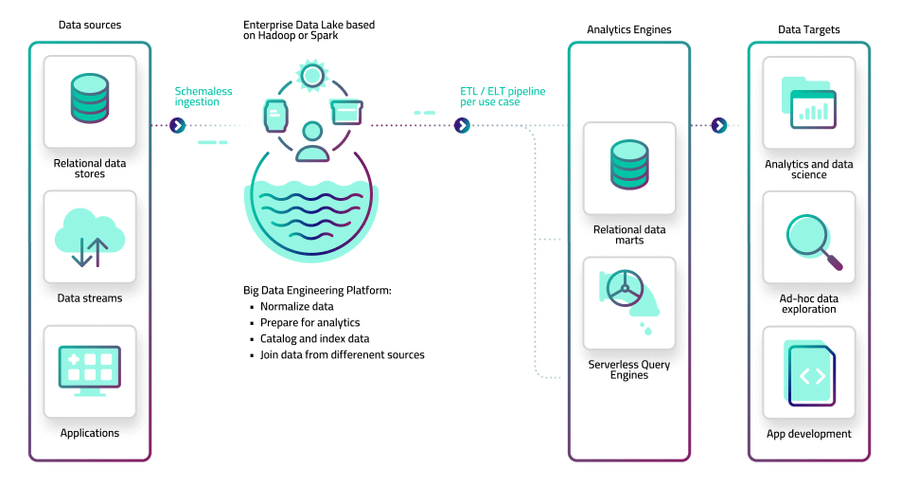
Session 3: Big Data Integration and Storage
Linear Programming – Transportation
Data Pipeline:
Notes:
Source of image: Upsolver
In this architecture, the monolithic data warehouse has been replaced with a data lake. Large volumes of data from different sources can now be easily ingested and stored in an object store such as Amazon S3 or on-premise Hadoop clusters, reducing the engineering overhead associated with data warehousing. The data lake stores data in its original, raw format, which means it can store complex and streaming data as easily as structured, batch files.
However, raw data in the lake is not in a queryable format, which necessitates an additional preparation layer that converts files to tabular data. The big data platform – typically built in-house using open source frameworks such as Apache Spark and Hadoop – consists of data lake pipelines that extract the data from object storage, run transformation code, and serve it onwards to analytics systems. These can be physical databases such as RDS, data warehouses such as Redshift or Snowflake, single-purpose systems such as Elasticsearch, or serverless query engines such as Amazon Athena or Starburst. BI and analytics tools would connect to these databases to provide visualization and exploration capabilities.

Slide 14
Session 3: Big Data Integration and Storage
Linear Programming – Transportation
A breakdown of common tools used in different parts of a data pipeline
1. Data Ingestion (Moving data from various sources into the pipeline):
Open-source:
Apache NiFi
Apache Flume
Apache Sqoop
Logstash
Kafka Connect
Cloud-based:
AWS Data Pipeline
AWS Glue
Google Cloud Dataflow
Azure Data Factory
Amazon Kinesis
Azure Stream Analytics
Commercial:
Informatica PowerCenter
Talend
Fivetran
Stitch
Hevo
Notes:
Source of image: Upsolver

Slide 15
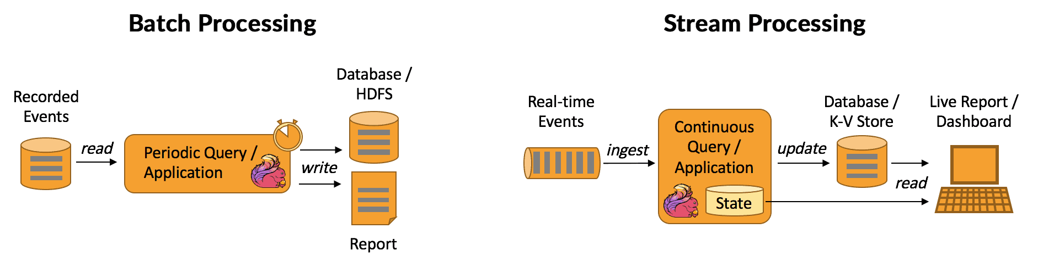
Session 3: Big Data Integration and Storage
Linear Programming – Transportation
A breakdown of common tools used in different parts of a data pipeline
2. Data Processing (Transforming and processing the data):
Notes:
Example: E-commerce Platform
Imagine you operate a large e-commerce platform where millions of transactions take place every day. There's a vast amount of data flowing in and out, including product views, user logins, orders, reviews, and more.
Batch Processing
Scenario: At the end of each day, you want to generate a sales report that provides an overview of the total sales, the most purchased products, the regions with the highest sales, and so on.
Why Batch Processing?
Volume: The amount of data is massive, covering all transactions for the entire day.
Complexity: The report requires comprehensive data processing, such as sorting, aggregating, filtering, and joining data from different sources (e.g., product database, user database, sales database).
Non-Time Sensitive: It's okay if the report isn't available immediately after a sale occurs; a delay until the end of the day is acceptable.
Real-time Inventory Management
Scenario: You want to keep track of product stock in real-time. Every time a product is sold, you want to decrement the stock count. If the stock falls below a certain threshold, you want to automatically reorder or send alerts to suppliers.
Why Stream Processing?
Immediate Action: You need to act on data immediately after a sale to ensure inventory accuracy and to avoid stockouts.
Continuous Flow: Data is continuously flowing in real-time as sales happen.
Time-Sensitive: A delay in processing can result in incorrect stock counts and potentially dissatisfied customers.
HDFS: Hadoop Distributed File System

Slide 16
Session 3: Big Data Integration and Storage
Linear Programming – Transportation
A breakdown of common tools used in different parts of a data pipeline
2. Data Processing (Transforming and processing the data):
Batch Processing:
Apache Hadoop (HDFS, MapReduce)
Apache Spark
Apache Pig
Talend
Amazon Redshift
Stream Processing:
Apache Kafka (Streams API)
Apache Storm
Apache Samza
Google Cloud Dataflow (Streaming)
Azure Stream Analytics
Flink
Amazon Kinesis
Google Cloud Dataflow

Slide 17
Session 3: Big Data Integration and Storage
Linear Programming – Transportation
A breakdown of common tools used in different parts of a data pipeline
3. Data Storage (Store Processed data):
Databases:
MySQL
PostgreSQL
MongoDB
Cassandra
Data Warehouses:
Amazon Redshift
Google BigQuery
Snowflake
Teradata
Data Lakes:
Hadoop Distributed File System (HDFS)
Amazon S3
Azure Data Lake Storage
Google Cloud Storage

Slide 18
Session 3: Big Data Integration and Storage
Linear Programming – Transportation
A breakdown of common tools used in different parts of a data pipeline
4. Data Analysis & Computation:
Data Analytics Platforms:
Apache Hive
Presto
Amazon Athena
Databricks
Machine Learning Platforms:
TensorFlow
PyTorch
Scikit-learn
Apache Mahout
AWS SageMaker
Azure Machine Learning

Slide 19
Session 3: Big Data Integration and Storage
Linear Programming – Transportation
A breakdown of common tools used in different parts of a data pipeline
5. Data Orchestration & Workflow Management (Managing and automating workflows):
6. Data Consumption (Visualization & Dashboarding):
Apache Airflow
Luigi
Prefect
Apache Oozie
AWS Step Functions
Tableau
PowerBI
QlikView
Grafana
Looker
Apache Superset

Slide 20
Session 3: Big Data Integration and Storage
Linear Programming – Transportation
A breakdown of common tools used in different parts of a data pipeline
7. Data Monitoring & Management (Ensuring data quality, monitoring data flow):
Datadog
Prometheus
Grafana (for monitoring as well)
Apache Ranger (for security)
Apache Atlas (for governance)

Slide 21

Session 3: Big Data Integration and Storage
Linear Programming – Transportation
Activity:
Scenario: Online Retailer - "ShopTrendy"
Background: ShopTrendy is an e-commerce platform selling a wide range of products from clothing to electronics. Given the massive number of customers and daily transactions, they wish to utilise machine learning to analyse and personalise customer needs, thereby improving sales and enhancing user experience. For this scenario:
A: Identify two internal and two external data sources that need to be collected.
B: Pinpoint at least three challenges the company might face in this process and propose solutions for each.
C: Design a data pipeline focusing on the data ingestion and data storage stages.

Slide 22
Session 3: Big Data Integration and Storage
Linear Programming – Transportation
Activity:
Scenario: Online Retailer - "ShopTrendy"
Data Pipeline: Data Ingestion:
Use Apache Kafka to ingest real-time data: such as clickstream.
Batch upload other sources periodically to the data lake.
Data Storage:
Store structured data in databases: Amazon Redshift.
A data lake solution: Amazon S3 or HDFS for semi-structured and unstructured data.

Slide 23
Session 3: Big Data Integration and Storage
Linear Programming – Transportation
Instructions for Designing an Effective Data Pipeline:
Define Your Objectives:
Clearly outline what you aim to achieve with your pipeline.
Identify the target users and list their specific needs.
Characterize Your Data Sources:
List all data sources and specify their formats.
Estimate the expected frequency, volume, and velocity of the incoming data.
Implement Data Quality Measures:
Incorporate steps for data validation and cleaning.
Develop mechanisms to handle missing, duplicate, or erroneous data.
Insert checkpoints to monitor data quality throughout the pipeline.
Ensure Scalability:
Design with the future in mind, accommodating potential growth in data volume.
Choose components that can be expanded as necessary.
5. Determine Latency Requirements:
Decide on your data processing approach: real-time, near-real-time, or batch processing.
6. Design for Flexibility and Extensibility:
Ensure that your pipeline can adapt to new sources or changes without a complete overhaul.
7. Prioritize Reliability and Fault Tolerance:
Integrate data backup and recovery solutions.
Incorporate retry mechanisms for processes that might fail and set up alert systems.
8. Prioritize Data Security:
Employ strategies to protect data both in transit and when stored.
Define strict access controls and permissions.
9. Stay Compliant with Data Governance:
Familiarize yourself with relevant data regulations and ensure your pipeline is compliant.
Embed auditing, logging, and data lineage tracking features.

Slide 24
Session 3: Big Data Integration and Storage
Linear Programming – Transportation
Instructions for Designing an Effective Data Pipeline:
10. Optimize Costs:
Be mindful of storage, computation, and transmission costs. Look for efficient solutions.
Periodically review your design for potential cost-saving adjustments.
11. Plan for Integration with Other Systems:
Ensure easy integration points are in place for both data ingestion and output.
12. Maintain Thorough Documentation:
Keep detailed documentation of your pipeline's architecture and flow.
Use version control systems and consider continuous integration/continuous deployment (CI/CD).
13. Set Up Monitoring and Alerting Mechanisms:
Continuously monitor your pipeline's health and performance.
Integrate alert systems for immediate notifications on issues or bottlenecks.
14. Establish Feedback Loops:
Design mechanisms to gather and implement feedback, ensuring your pipeline remains effective and relevant.
15. Test Rigorously:
Incorporate various testing methods, from unit to end-to-end tests.
Simulate realistic data loads and scenarios to validate your pipeline's performance.

Slide 25
Break
Linear Programming – Transportation
10 mins break
Set Up your Jupyter We will do some coding to create a database in MongoDB by Python

Slide 26
Questions?

